Slide 1


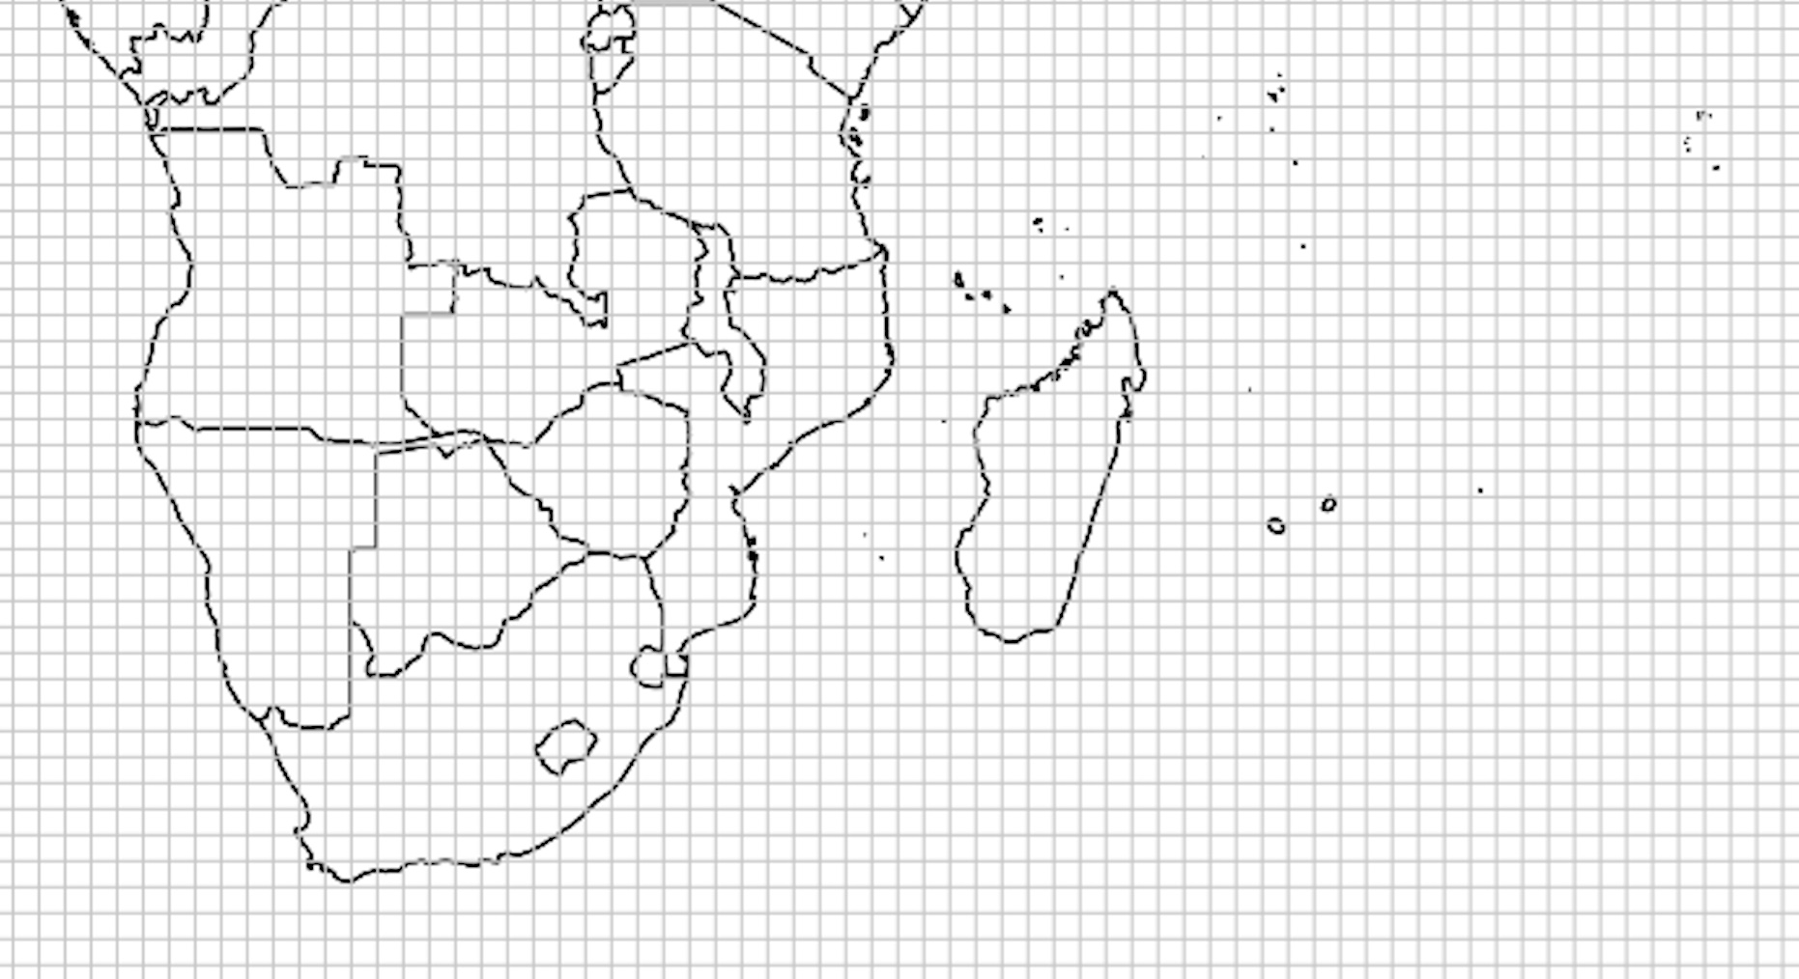
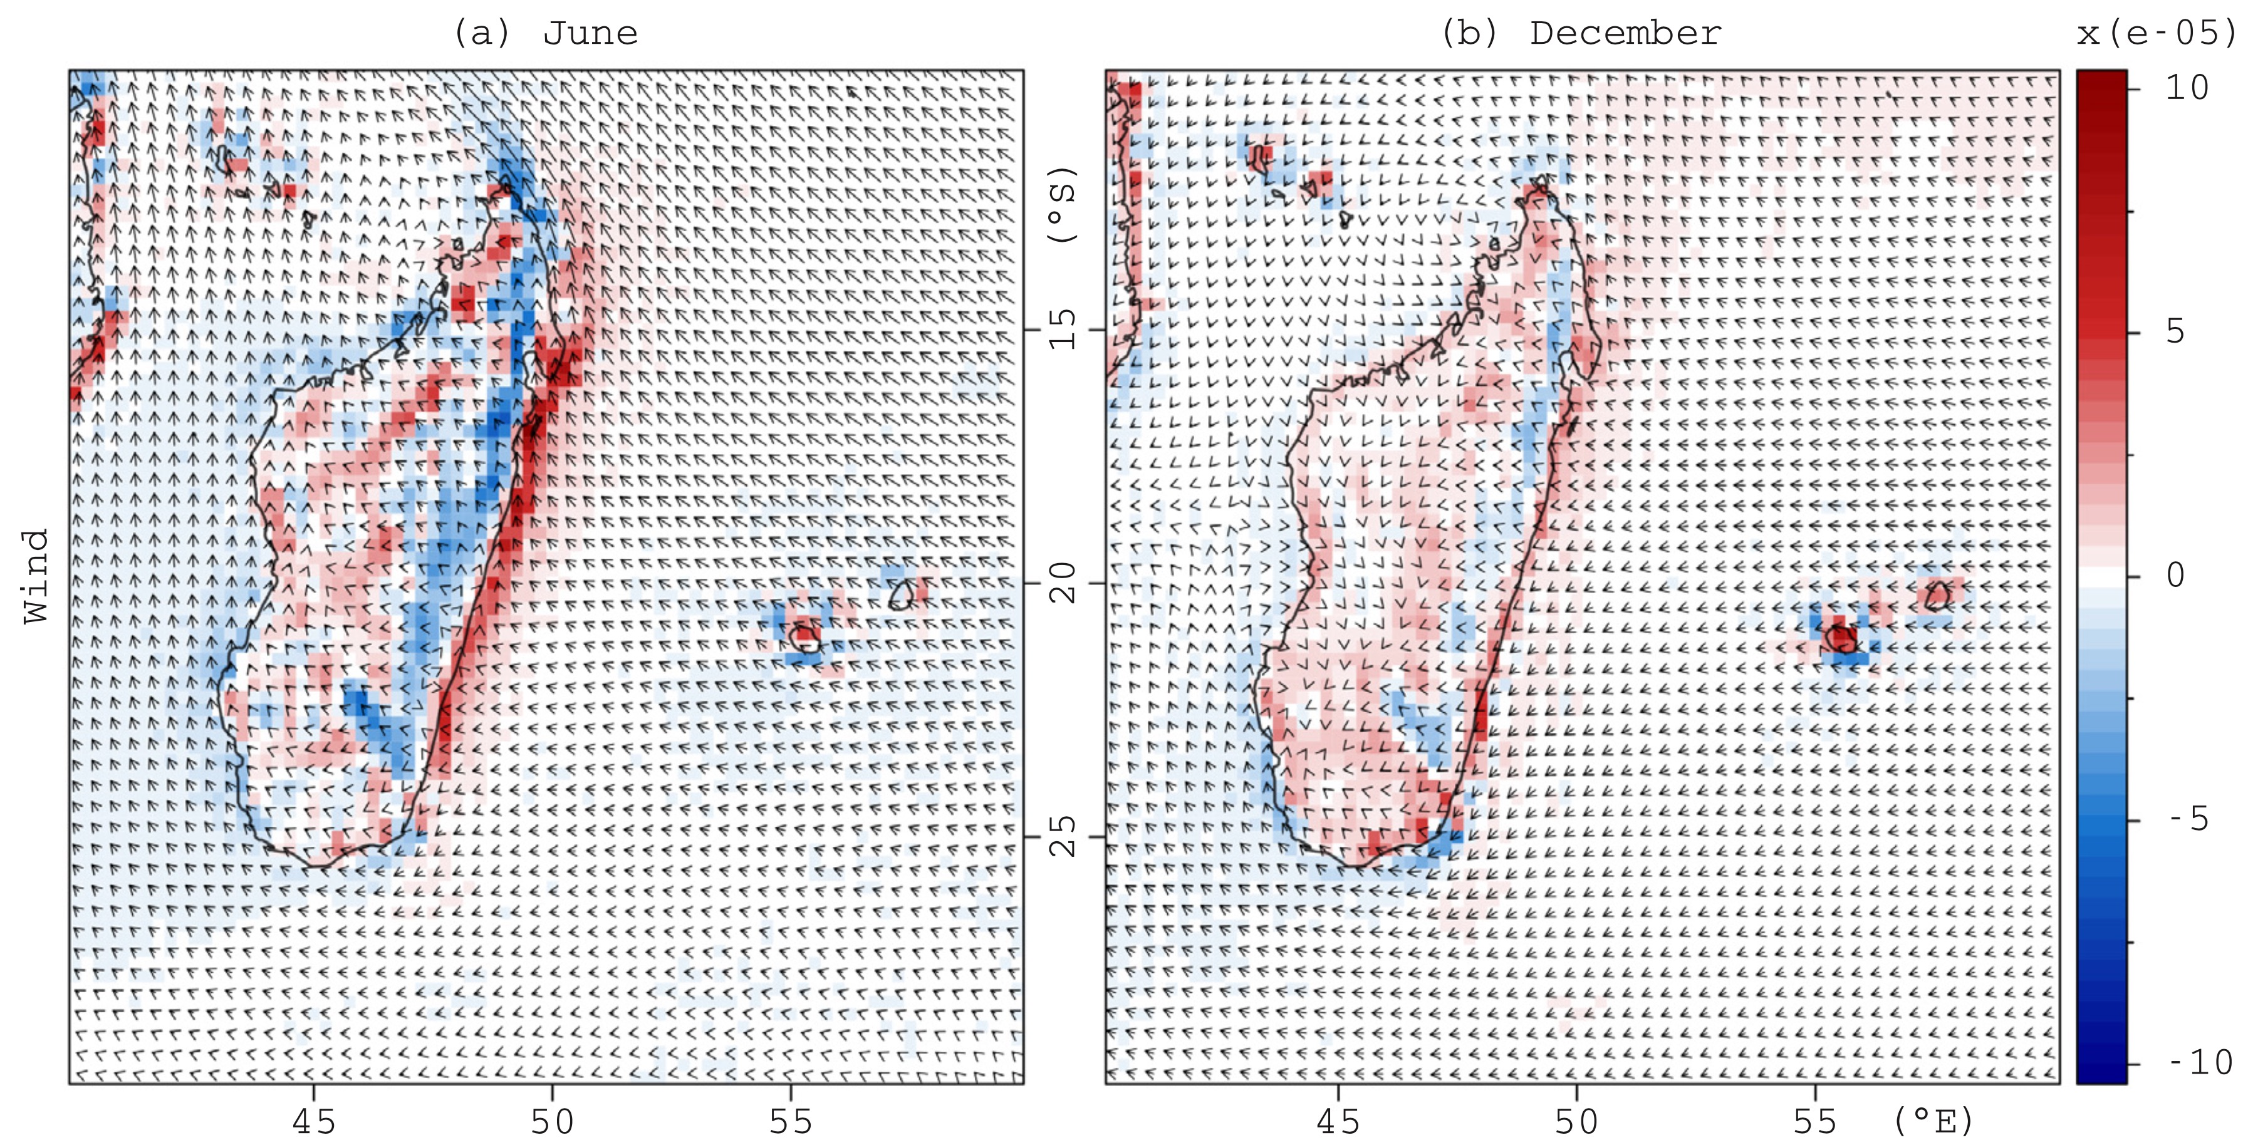
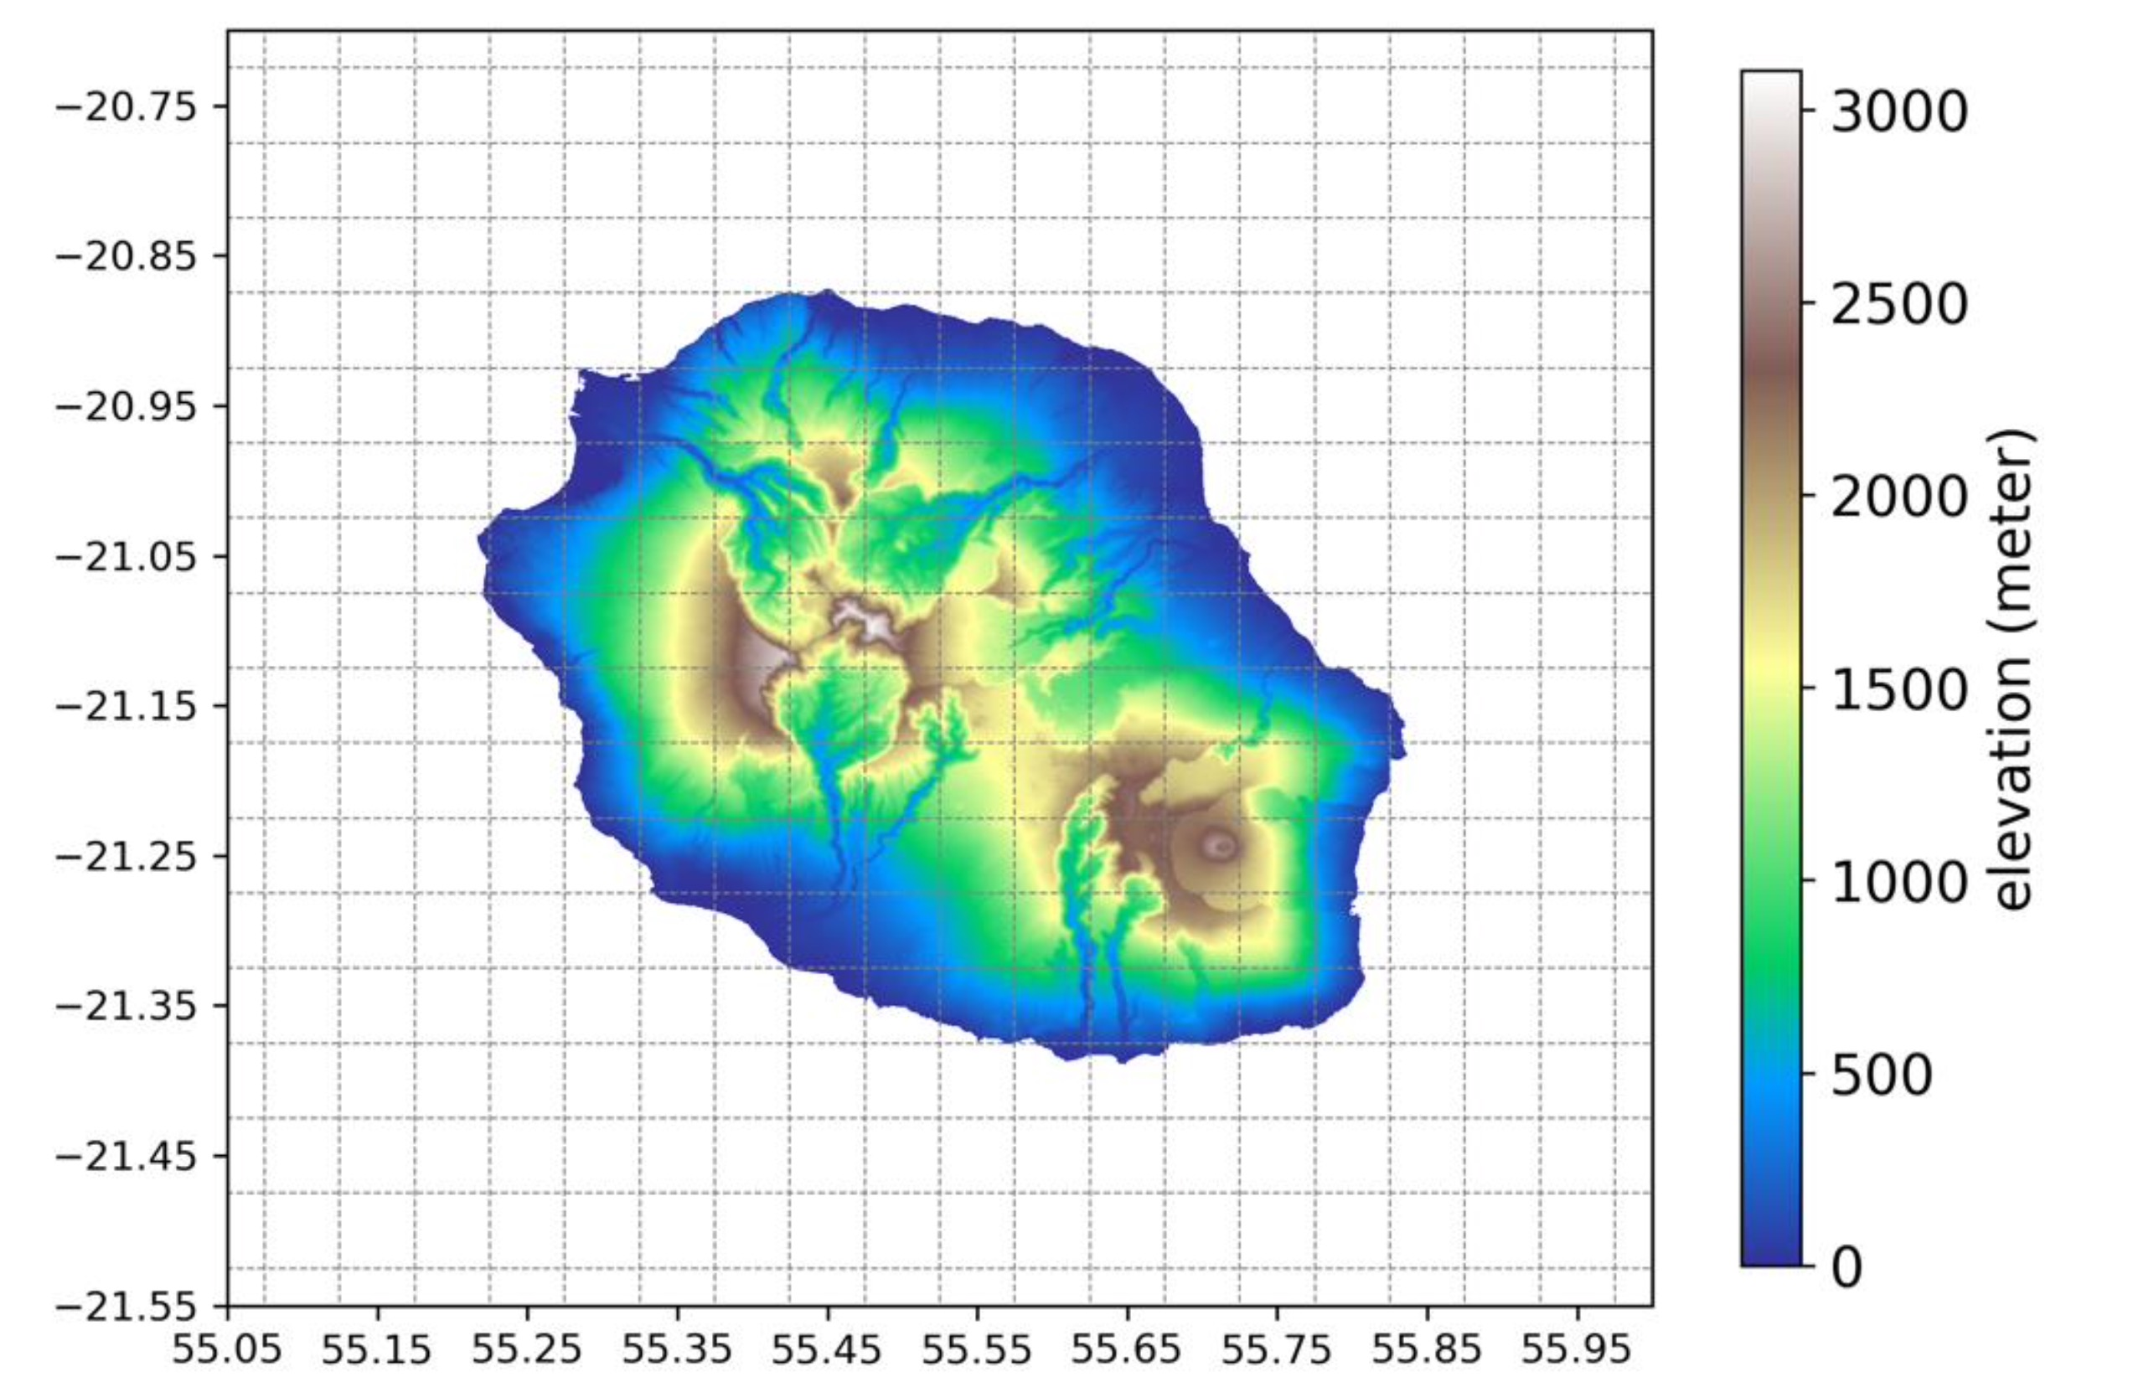
Primary results: Wind resource REU
Seasonal trade winds
Remarked topography
Winter wind
Summer wind
Mialhe et. al 2020
Tang et. al 2023

Slide 2
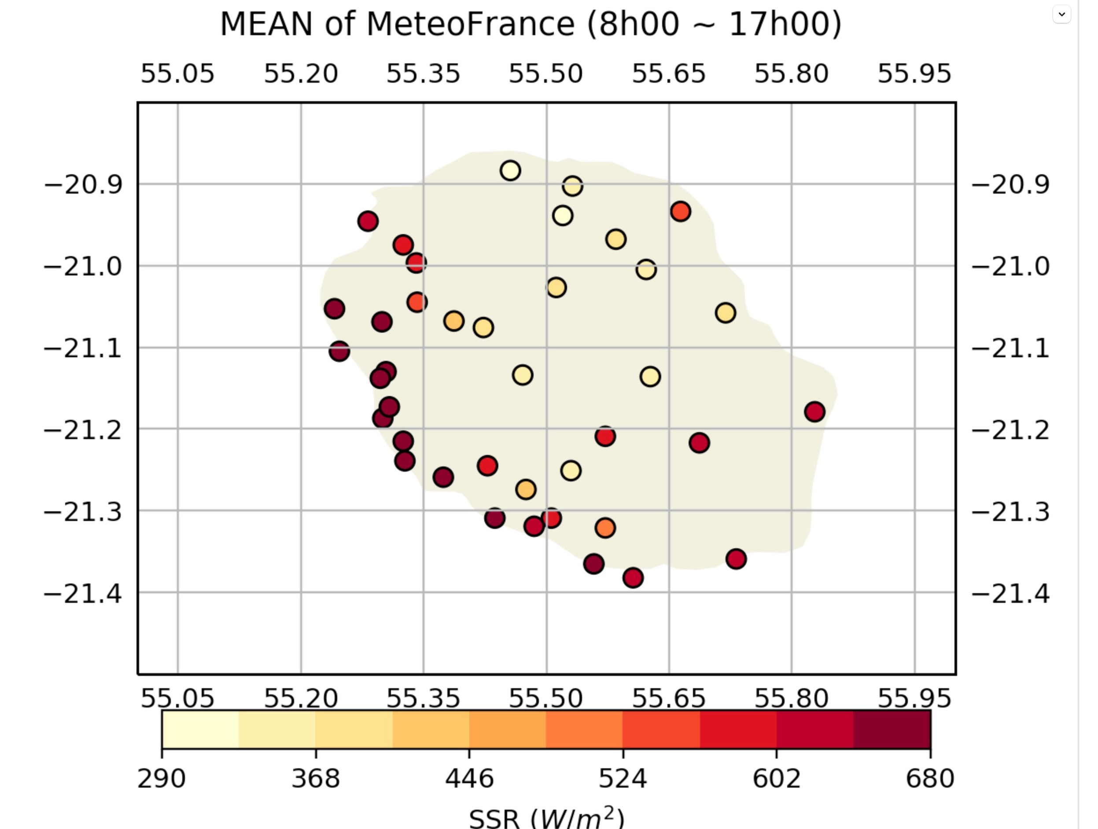
Wind resource in Reunion: mean state
10m annual mean wind speed of Reunion
observation
Looks like the left one
Same lon, lat, colorbar
ERA5 @25km
Mean value of: land, ocean, and all in each plot.
Yearly mean
Same lon, lat, colorbar
Same lon, lat, colorbar
Same frame same colorbar.
ERA5_land @9km
AROME @2.5km

Slide 3
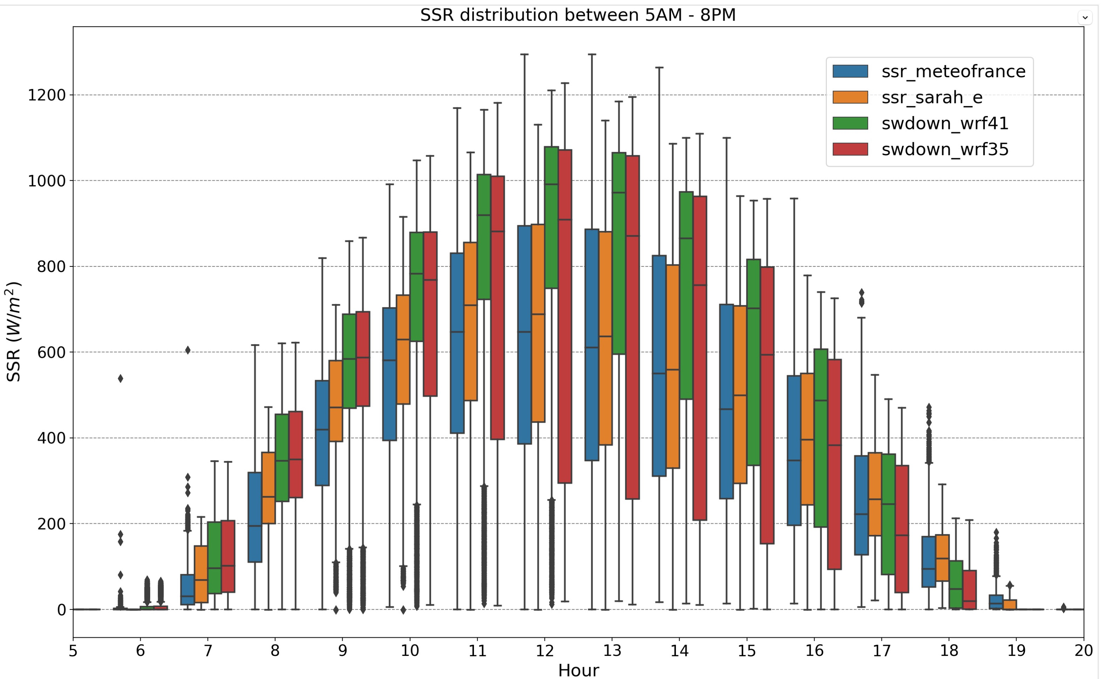
Wind resource in Reunion var. temp. seasonal
Seasonal cycle of wind speed (daily mean)
Using spatial mean to plot the seasonal cycle, like the right one (but in months).
Using obs, ear5, era5_land, arome
Daily data, all the year

Slide 4
Wind resource in Reunion: diurnal cycle : hourly data ,spatial mean
Seasonal cycle of wind speed (daily mean)
Using spatial mean to plot the diurnal cycle, like the right one
Using obs, ear5, era5_land, arome
Horly, 24 hours, all data
All, sea, land

Slide 5
Wind resource in Reunion: diurnal cycle : hourly data ,spatial mean
Seasonal cycle of wind speed (daily mean)
Quick question:
How grided data represents the annual mean, diurnal/annual cycle ?
Conclusion may be different depending on the area: All, sea, land

Slide 6
Vari. Spatial. Obs, arome,
maps
Using obs, (ear5, era5_land shown with conclusion of insufficient reso.), arome
Summer/winter daily mean, all data

Slide 7
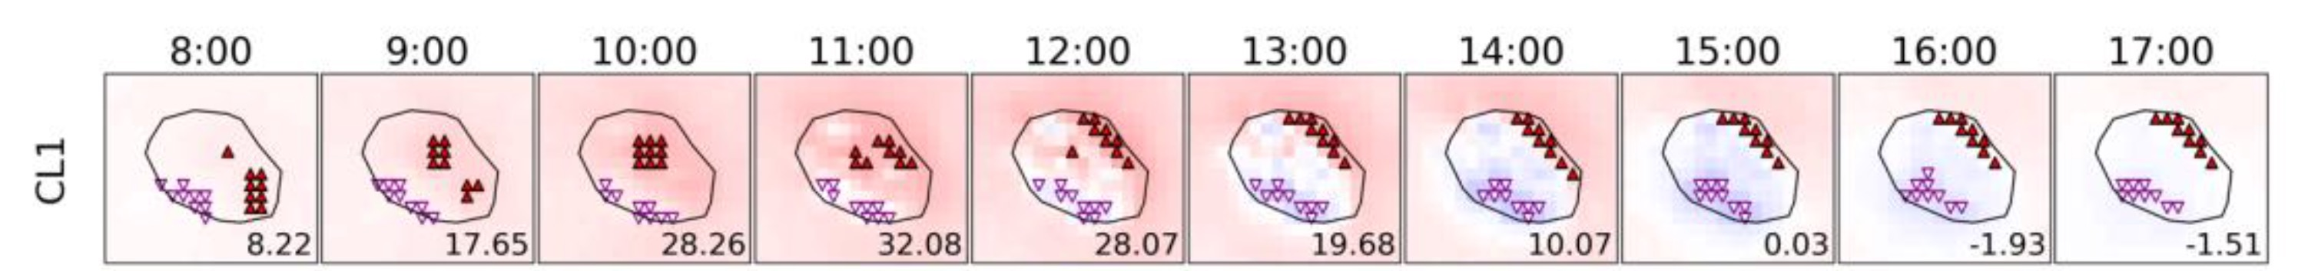

Vari. Spatial. Obs, arome,
Obs, and ARome,
24 hourly maps for each data in summer/winter

Slide 8
Conclusion
Selection of stations:
 | lon | lat | altitude
1
2
3
4

Slide 9
Conclusion
Selection of stations:
Wind profile, hourly data, with legend of East, west, high stations

Slide 10
Conclusion
Selection of stations:
Seasonal cycle (box plot ) of East West High stations (daily mean data)

Slide 11
Conclusion
Selection of stations:
diurnal cycle (box plot ) of East West High stations (hourly data)

Slide 12

Conclusion for Reunion
Take-home message:

Slide 13
Future work

Slide 14

















logos

